Slide 1
WELCOME
TO OUR
PRESENTATION
Presented by: Group 7

Slide 2


Slide 3


05-2021
THE FINAL PROJECT
BUSINESS ANALYTICS
Subject: Management Information System
Lecturer: PhD. Ho Trung Thanh
Tutor: Miss. Huynh Tieu Yen

Slide 4

Table of Content
Part 1: Introduction to Amazon
Part 2: Amazon Porter’s Five Competitive Forces Model
Part 3: Some MIS solutions implemented by Amazon
Part 4: How Amazon takes advantage of IS to deal with competitive forces?
Part 5: Business Analytics
Part 6: Amazon Business Value Chain

Slide 5
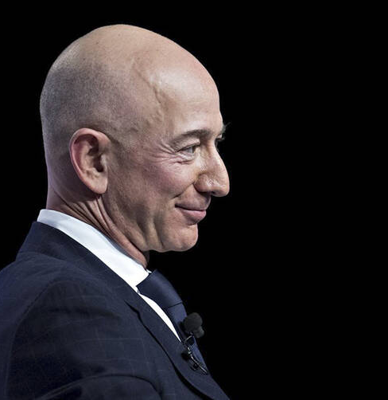

PART 1
THE HISTORY OF AMAZON
An American online business and cloud computing company.
Jeff Bezos
Founded on July 16, 1995

Slide 6
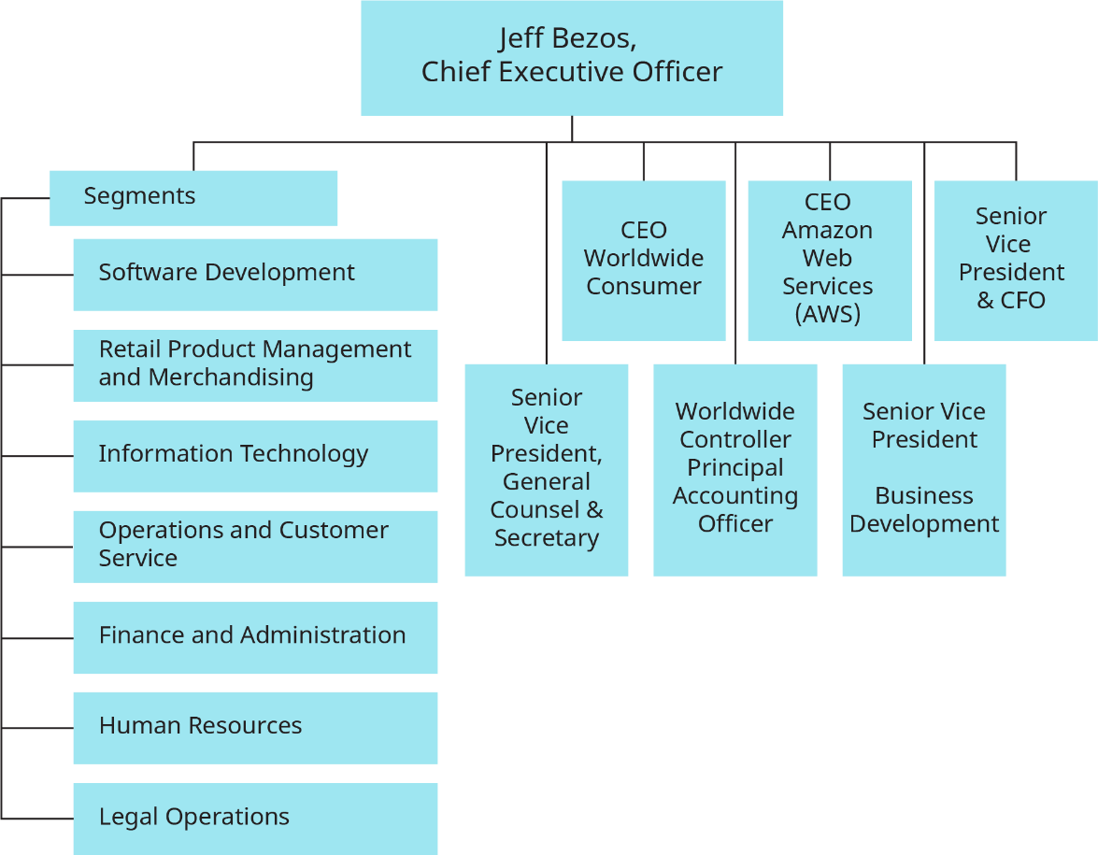

03
ORGANIZATIONAL STRUCTURE

Slide 7


THE HISTORY OF AMAZON
About Amazon
It is the largest Internet-based store and one of the most successful brand in the world
02

Slide 8
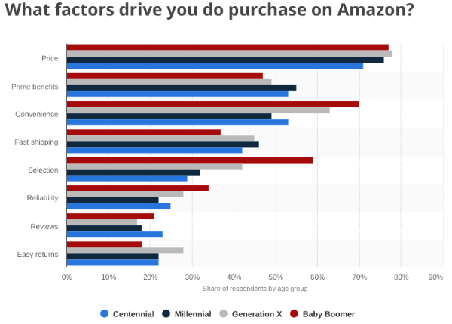
Customers choose Amazon for 3 main reasons:
Low prices
Vast selection
Fast delivery speed
Amazon brings accurate pricing, product to meet the needs of shoppers
Customers can see almost every possible purchase option in one place
Amazon Prime
‹#›

Slide 9
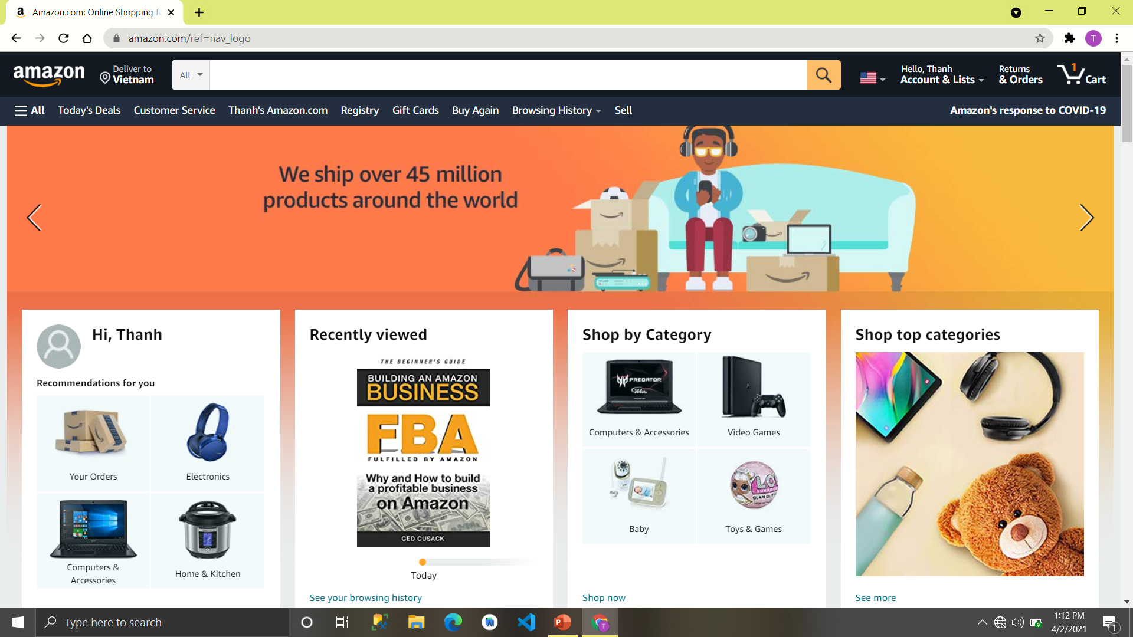

Slide 10
THE HISTORY OF AMAZON
About Amazon
MISSION STATEMENT
VISION STATEMENT
“
“
Serve consumers through online and physical stores and focus on selection, price, and convenience.
To be Earth’s most customer-centric company, where customers can find and discover anything they might want to buy online, and endeavors to offer its customers the lowest possible prices.”
”
”

Slide 11
THE HISTORY OF AMAZON
About Amazon
MISSION
Technology
Customer Experience
CUSTOMER FOCUS
UX
CX
CONTENT, MERCHANTS
FIND, DISCOVER & BUY
Notes:
The figure above reflects that amazon.com wants to be global leader in e-retailing business by providing the quality products at affordable price using latest technology to build the customer database and gain their loyalty towards the brand; thereby generating profits to the company.

Slide 12
E-Business model of Amazon
BUSINESS TO BUSINESS (B2B)
BUSINESS TO CONSUMER (B2C)
CONSUMER TO CONSUMER (C2C)
MOBILE COMMERCE (M-COMMERCE)
Amazon Business Sellers Program.
Amazon Business Buyers Program.
Consumers can purchase directly from Amazon's website
Amazon allows consumers to list items to sell to other consumers
Amazon enables customers to conduct commercial transactions online, including the purchase and sale of products, online banking, and paying bills

Slide 13
Part 2
Traditional Competitors
Threat of New Entrants
Porter’s Five Forces Competitive
Threat of Substitutes
Customers
Suppliers

Slide 14
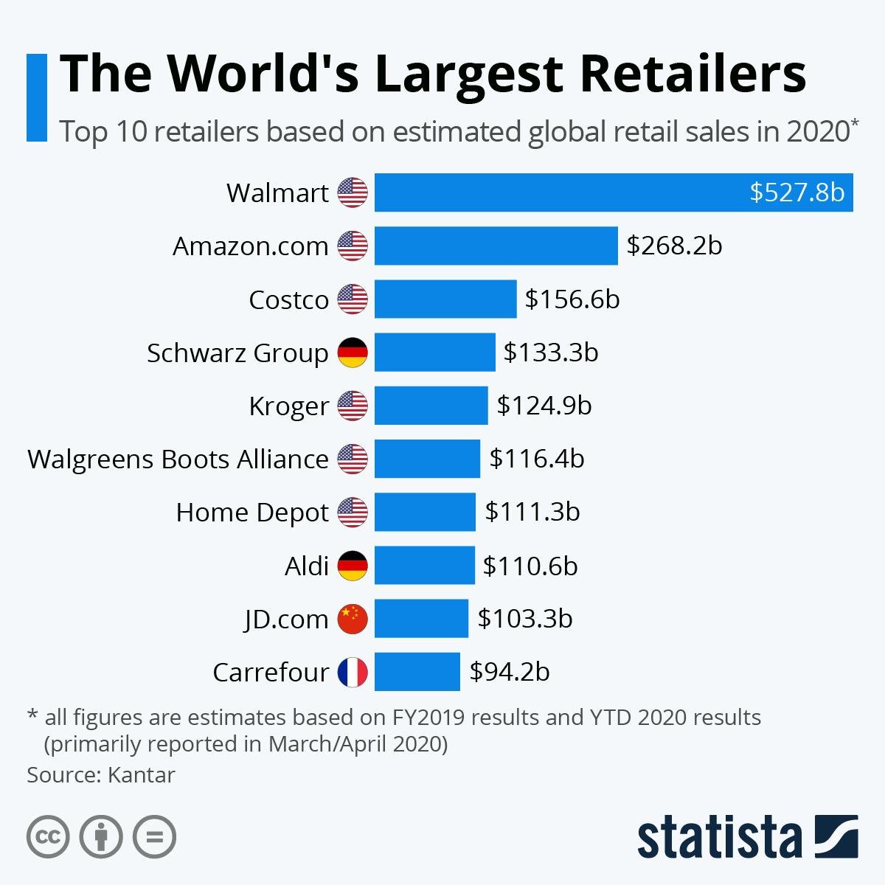






TRADITIONAL COMPETITORS
Main competitors
Others
The other retailers, small scale brand, and startups and also many local brands
The threat is high
‹#›

Slide 15
NEW MARKET ENTRANTS
Huge Investment
Economies of Scale
It would require billions of dollar investment and, years of patience, to compete with Amazon.
New players can’t potentially use economies of scale at the same extent as Amazon
Customer Loyalty
Amazon invested heavily in customer experience to give them the best experience in the market
The threat is low
‹#›

Slide 16

Amazon competes with substitutes in the online retail as well as with the offline retail market.
The low switching cost in the industry, the easy availability of substitutes at a cheap rate.
Substitute Products & Services
The threat is high
Switching costs are the costs that a consumer incurs as a result of changing brands, suppliers, or products.

Slide 17

Customers generally have high bargaining power because of the intense competition in the retail industry.
Customers tend to be price sensitive. If Amazon does not provide them with high-quality service at the best price, they will go for its substitute in the market.
Customers
The threat is high
Notes:
For example, instead of purchasing on Amazon’s e-commerce website, a customer can easily go to one of Walmart’s stores, which are located throughout the United States.

Slide 18


Amazon is the most prominent player in the industry
Amazon wants to ensure that the suppliers it is purchasing are following ethical working principles. The switching cost for suppliers is almost negligible.
Suppliers
The threat is low to morderate
Switching costs are the costs that a consumer incurs as a result of changing brands, suppliers, or products.

Slide 19




MIS SOLUTIONS
Enterprise Resource Planning
Part 3
Customer Relationship Management
Supply Chain Management
‹#›

Slide 20

Amazon has been using SAP as its ERP system for its business processes.
SAP Basis / NetWeaver Administration
SAP Business Suite
SAP BusinessObjects
SAP HANA
SAP Mobility
Enterprise Resource Planning
Automating many processes with high levels of accuracy in scheduling and tracking
Increasing efficiency, and enhanced Reporting-Planning process

Slide 21
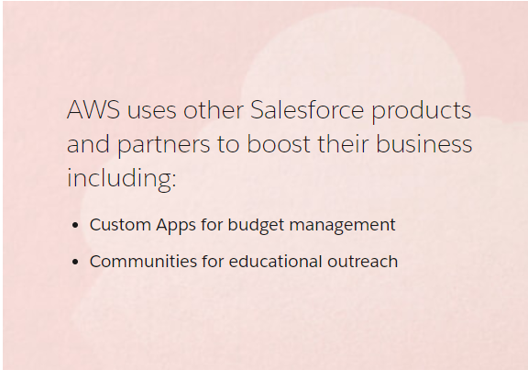
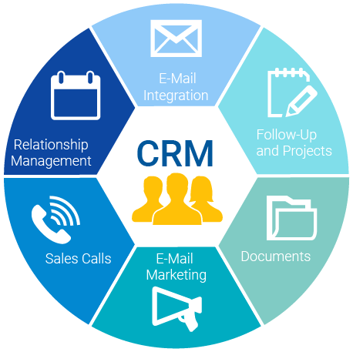
Amazon is using Salesforce to collect customer data such as the credit card information, transaction history, and order records, then use that data to instantly modify and customize a user's overall on-site experience
Customer Relationship Management

Slide 22
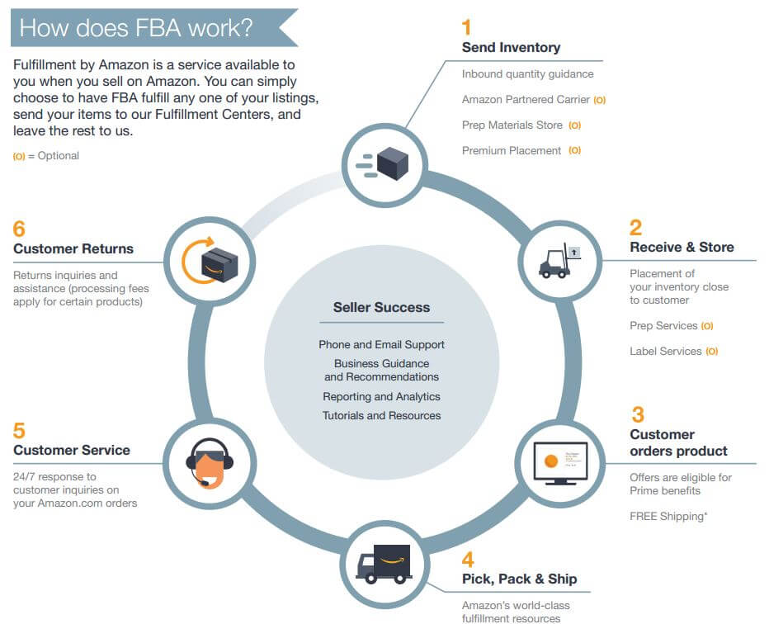

Amazon has different fulfillment options to choose from:
Fulfillment by Amazon (FBA) – Sellers leverage Amazon’s fulfillment for products sold on the Amazon Marketplace
Or sell using your own fulfillment (FBM) – Sellers handle fulfillment for their products sold on the Amazon Marketplace
Supply Chain Management

Slide 23





IS STRATEGIES TO DEAL WITH COMPETITIVE FORCES
Low-cost Leadership
Product Differentiation
Focus on Market Niche
Strengthen Customer and Supplier Intimacy
Part 4

Slide 24
IS STRATEGIES TO DEAL WITH COMPETITIVE FORCES
01
02
Low-cost Leadership
Product Differentiation
Maximize operational efficiency and automation in operational processes.
Minimize the cost of its online retail and other services
Prime Delivery: Amazon gives customers fast and free shipping through Prime Now and Prime Air
One-Click Purchase: Amazon allows customers to purchase by one-click, which is easy and fast

Slide 25
IS STRATEGIES TO DEAL WITH COMPETITIVE FORCES
03
04
Focus on Market Niche
Strengthen Customer and Supplier Intimacy
Amazon implemented CRM to collect customer data to customize users’ online experience
Amazon optimizes the supply chain – from warehousing and inventory management to delivery times and prices
Amazon uses Business Analytics to analyze customer information
Pitching suitable advertising and marketing campaign to target markets

Slide 26





BUSINESS ANALYTICS
Definition
Part 5
Different types
Process
Implementation
‹#›

Slide 27
BUSINESS ANALYTICS
SOLUTIONS
ANALYZING
IMPROVEMENT
Using statistical methods and technologies
Historical data
New insight
Better decision-making
DEFINITION

Slide 28
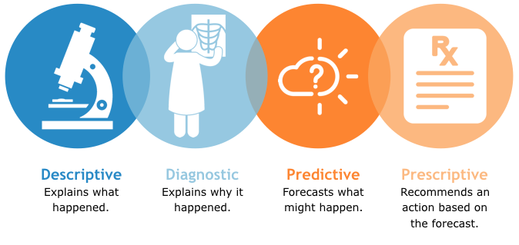
BUSINESS ANALYTICS
DIFFERENT TYPES

Slide 29
BUSINESS ANALYTICS
Business Demand
Collect Data
Analyze Data
Predict
Find Best Solution
Make Decision
Update
PROCESS
Notes:
●First the business will determine what they need
●Next they'll collect the data. This could be structured data or unstructured data
●Once the data is collected, it is analyzed based on the need that was identified in the step 1
●After analyzing data, the business can make certain predictions to find the best solution
●Based on that solution, managers can make decisions
●The final step - is to evaluate the effectiveness of the decision and update the information the business has access to. This evaluation generally leads back to the first step where decision makers can use the information acquired and analyzed for an initial need to determine what other needs the business may have.

Slide 30






UX/UI OF
Simple
More facilities
Detailed description
Faster & Esier
One-click purchase
The simplest UI
Easy to use and navigate
Digital wallet
Grocery store
Selling options
Product reviews
Recommendation
Similar products
Scan to find product
Drop-down menu
Searching options
Security
Fast payment gateway
UX: User Experience
UI: User Interface

Slide 31



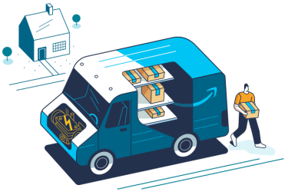
BUSINESS ANALYTICS IMPLEMTATION in AMAZON
Sales and Marketing
Understanding Customer
Shipping Products

Slide 32







BUSINESS ANALYTICS in SALES &MARKETING
Sales & Marketing
Business Analytics
Valuable
Increase Profit
Notes:
Amazon uses Business analytics in sales and marketing to increase profit, thorough up-selling and cross-selling. Business analytics helps Amazon to consider a specific buyer’s purchase history and make an educated guess to determine the other products a customer might find valuable.

Slide 33
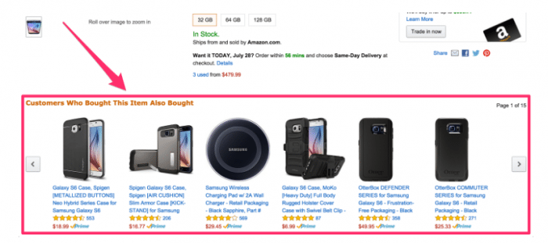
BUSINESS ANALYTICS in SALES &MARKETING
FOR EXAMPLE
Notes:
For example, if you just bought a new phone, you’re probably going to want some accessories, too. Based on predictive and prescriptive analytics, Amazon will make suggestions relevant to a recent purchase. As you can see in the picture, Amazon recommends other items for customers through “Customers who bought this item also bought”

Slide 34

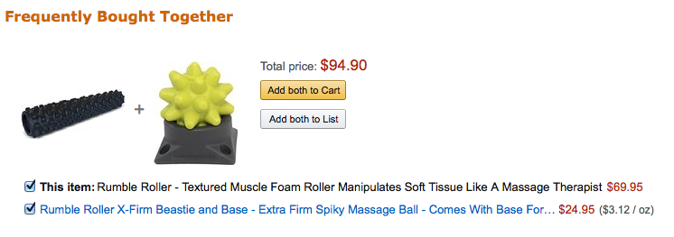
BUSINESS ANALYTICS in SALES &MARKETING
FOR EXAMPLE
Notes:
For example: Cross-selling strategies were conducted base on predictive analytics to recommend for customers items that frequently bought together, so they tend to buy the combo and therefore increase sales

Slide 35
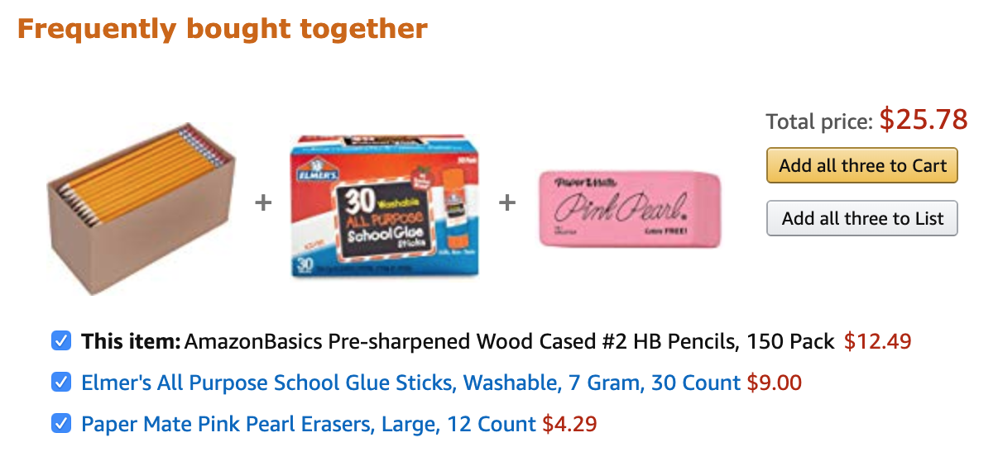
BUSINESS ANALYTICS in SALES &MARKETING
FOR EXAMPLE

Slide 36
BUSINESS ANALYTICS in UNDERSTANDING CUSTOMER
ANALYZE INFORMATION
RECOMMEND PRODUCT
STREAMLINE PROCESS
INCREASE PROFIT
RECOMMENDATION ENGINE
Utilise business analytics
Purchasing Patterns of Customer
Suggest additional or related items
Persuading customer to buy more products
Account for 35% company annual sales

Slide 37

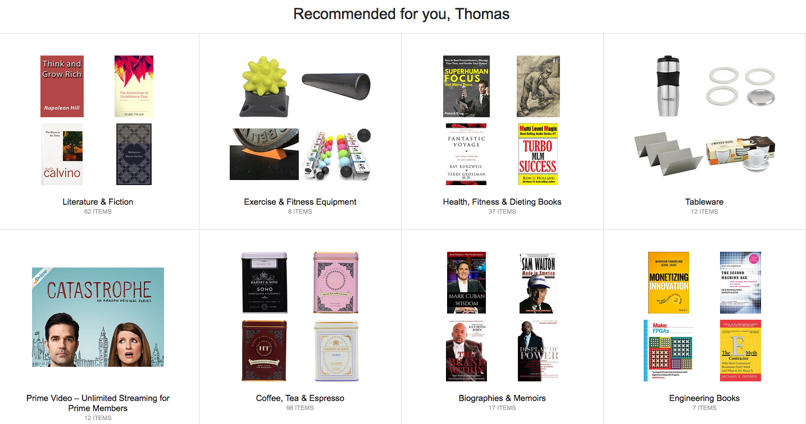
BUSINESS ANALYTICS in UNDERSTANDING CUSTOMER
FOR EXAMPLE
Notes:
For example, when Clicking on the “Your Recommendations” link on Amazon.com , it will lead users to a page full of products recommended just for you. Amazon recommends a range of products from different categories you’ve been browsing, with the aim of putting products in front of you that you’re likely to click and buy.

Slide 38

In 2013, Amazon integrated the social networking service of roughly 25 million users with some Kindle functions. This enabled the users to highlight words and notes. The company benefited from this to regularly monitor the highlighted words in Kindle to know about the interest of the readers. They analyze this data to recommend ebooks to their customers and also to enhance the reading experience.
BUSINESS ANALYTICS in UNDERSTANDING CUSTOMER
In 2013, Amazon integrated the social networking service of roughly 25 million users with some Kindle functions. This enabled the users to highlight words and notes. The company benefited from this to regularly monitor the highlighted words in Kindle to know about the interest of the readers. They analyze this data to recommend ebooks to their customers and also to enhance the reading experience.
FOR EXAMPLE

Slide 39
BUSINESS ANALYTICS in SHIPPING PRODUCT
ANTICIPATORY SHIPPING
ANALYZE
Customer historical shopping data
Ultilise business analytics
PREDICT
PRESCRIBE
The probability to buy product of customer
Ship the product to customer with an expected order date
PREPARE
DELIVERY
Package and dispatch the product to a local warehouse until a real order has arrived
The product is delivered to the customer – almost instantaneously
Notes:
Amazon used to announce that “it would be shipping the products even before the customer buys it.” Amazon can do that because they have utilized BA in “anticipatory shipping” system to analyze customers’ historical data -> predict the probability -> dispatches the product -> the order arrives, the product is delivered to the customer instantaneously.

Slide 40
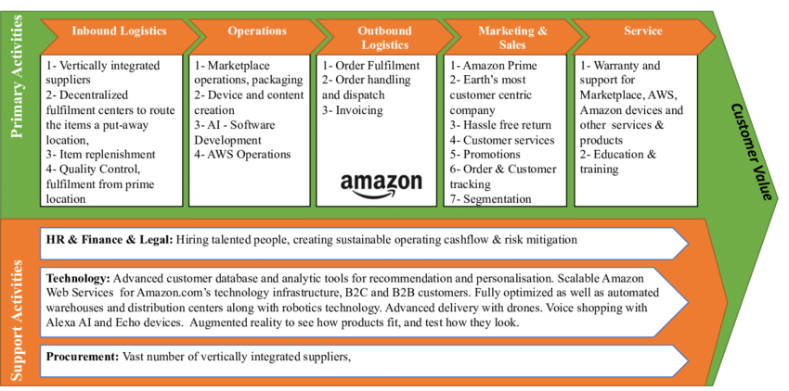
AMAZON BUSINESS VALUE CHAIN
Part 6
‹#›
Notes:
BA can help companies
- Measure how much of their mission statement is accomplished.
- Provides Clearer Insights Through Data Visualization.
- Keep the company Updated.
- Offer Efficiency.
- Identify breakdown in process or performance -> give the ability to view accurate data -> make better business decisions more quickly.

Slide 41
THANKS FOR LISTENING
Presented by: Group 7

Slide 42
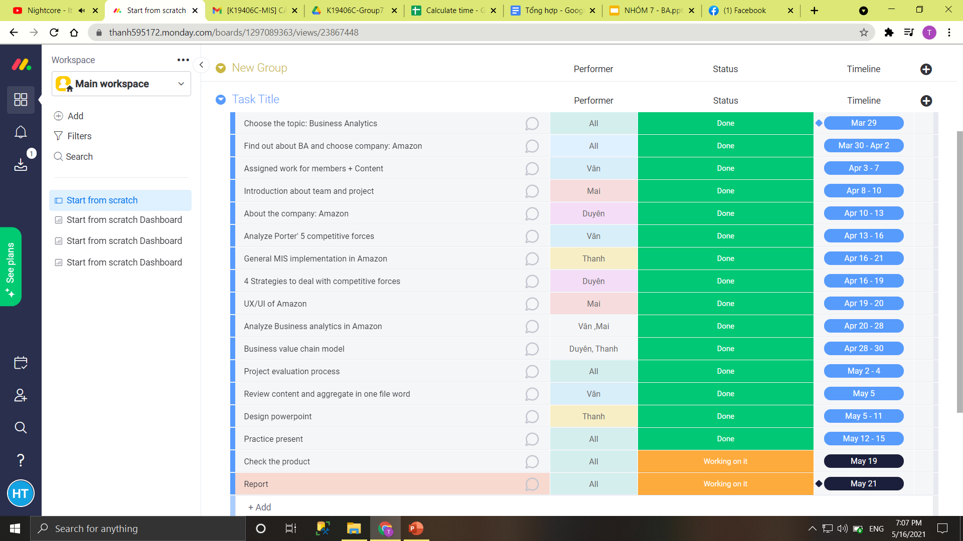
GROUP ASSIGNMENT

Slide 43
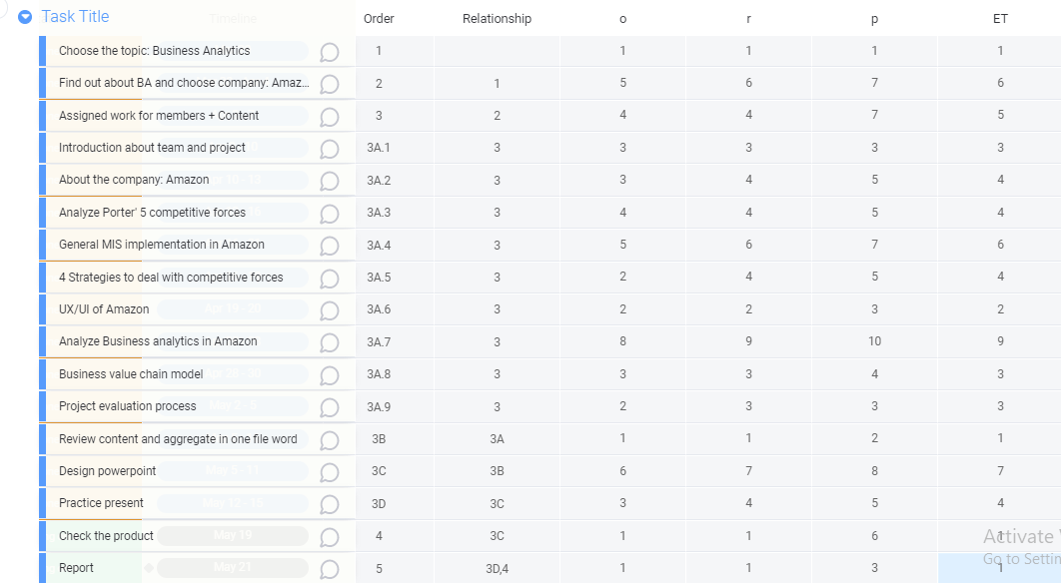
CALCULATION TIME

Slide 44
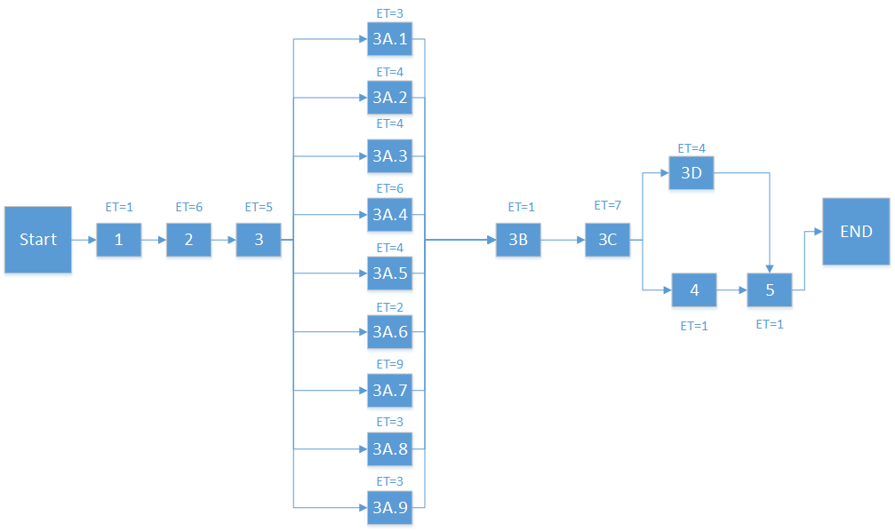
PERT MODEL

Slide 45
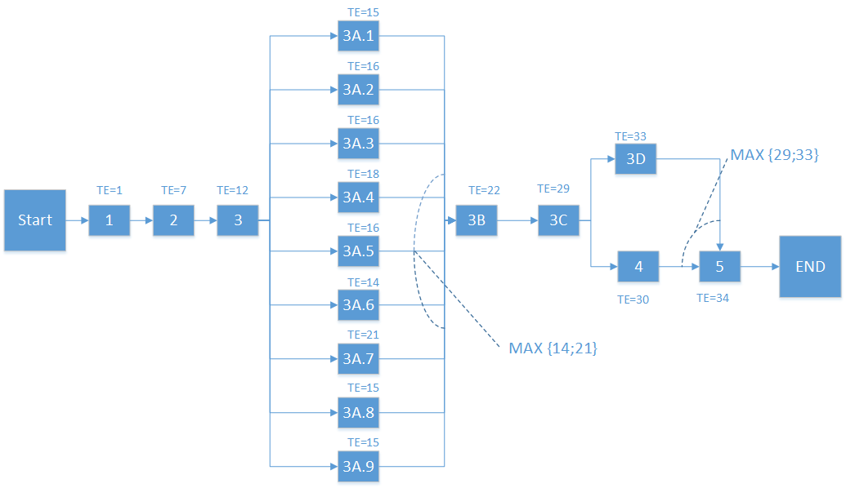
PERT MODEL

Slide 46

PERT MODEL

Slide 47
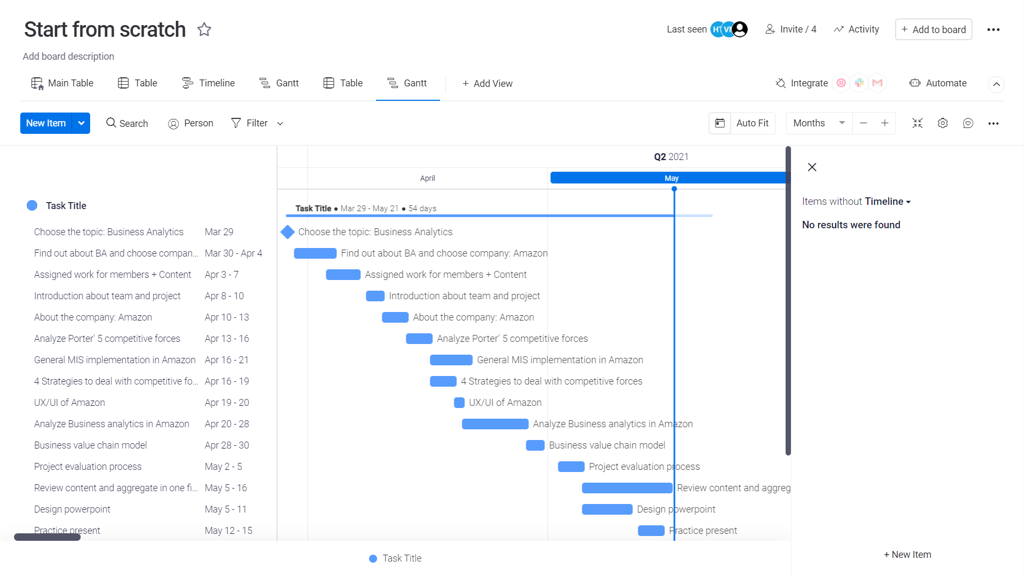
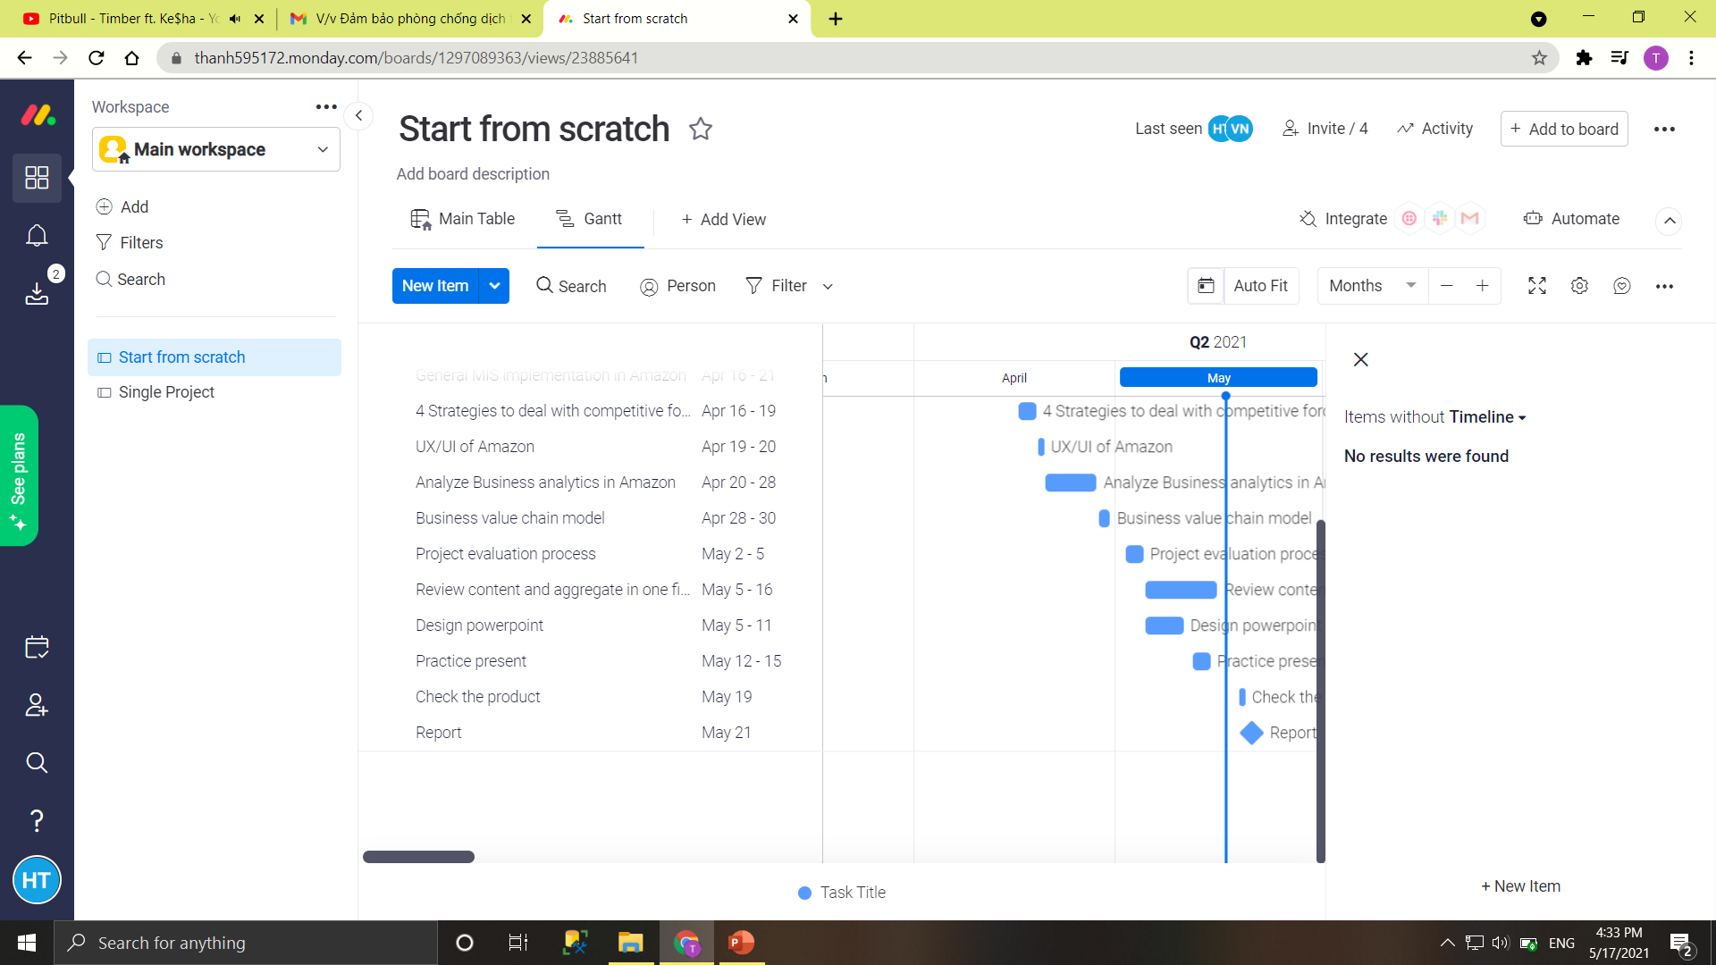

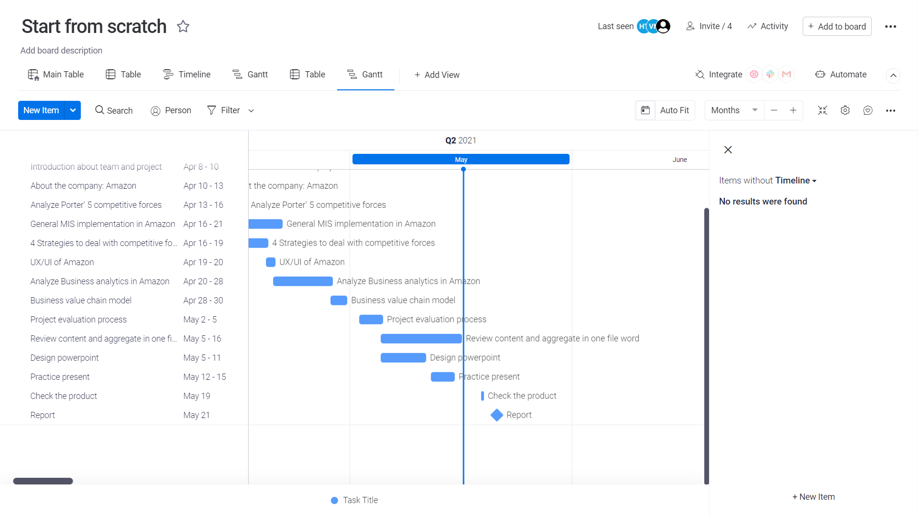
GANTT MODEL

Slide 48
REFERENCES
[1]. Tara Johnson, “How the Amazon Supply Chain Strategy Works” , Feb 19, 2020, Viewed date: May 5,2021
<https://tinuiti.com/blog/amazon/amazon-supply-chain/>
[2]. Atul Chakrawarty, “Amazon’s Customer Relationship Management Strategy”, December 13, 2017, Viewed date: April 26,2021
<https://www.linkedin.com/pulse/amazons-customer-relationship-management-strategy-atul chakrawarty>
[3]. Salesforce, “Discover how Amazon Web Services keeps their customers flying high”, 2020, Viewed date: April 26,2021
<https://www.salesforce.com/customer-success-stories/aws/>
[4]. John Dudovskiy, “Amazon Value Chain Analysis”, April 2, 2020, Viewed date: May 1,2021
<https://research-methodology.net/amazon-value-chain-analysis-2/>
[5]. Nupur Pal, “How Amazon’s UI UX design has made it one of the most glorified online shopping destinations?”, Oct 10,2020, Viewed date: April 27,2021
<https://www.cronj.com/blog/usable-features-of-amazons-ui-ux-design/>
[6]. Bernard Marr, “How Amazon uses Big Data in practice”,2020, Viewed date: May 5,2021
<https://www.bernardmarr.com/default.asp?contentID=712>

Slide 49
REFERENCES
[7]. Amazon, “What is Business Analytics?”, 2020, Viewed date: April 16, 2021
<https://aws.amazon.com/vi/business-analytics/>
[8]. Rahul Sachdeva, "Prescriptive Analytics: The Next Leap", Aug 29, 2014, Viewed date: April 16, 2021
<https://m.grazitti.com/blog/prescriptive-analytics-the-next-leap/>
[9]. Christopher McFadden, “A Very Brief History of Amazon: The Everything Store”, Feb 17, 2021, Viewed date: April 10,2021
<https://interestingengineering.com/a-very-brief-history-of-amazon-the-everything-store>
[10]. Gary Fox, “Amazon Business Model”, February 4, 2020, Viewed date: April 10,2021
<https://www.garyfox.co/amazon-business-model/ >
[11]. Roberta Greenspan, “Amazon.com Inc. Five Forces Analysis & Recommendations (Porter’s Model)”
, Feb 24,2019, Viewed date: April 30,2021
<http://panmore.com/amazon-com-inc-five-forces-analysis-recommendations-porters-model>
[12]. Marketing10, “Porter’s Five Forces Analysis of Amazon”, July 4, 2020, Viewed date: April 16,2021
<https://www.marketing10.in/porters-five-forces-analysis-of-amazon/>

